Slide 1

Development of features and components for ecommerce websites
Submitted by:
Hirak jyoti nath (Csm17033)
Mca 6th sem
tezpur university

Slide 2
About The Organisation
GetPY is a startup company based in Bengaluru. GetPy provides Sales & Marketing Intelligence Platform for businesses. It primarily provides CRM, ERP and vendor management systems, along with printing data at billing counters to provide intuitive, meaningful analytics to SMEs (Small and Medium Enterprises). GetPy has clients from various verticals like apparel, fashion, jewellery, restaurants, electronics stores, and automobiles. Currently, GetPY has over 100 clients in the UAE and 500-plus stores across India.

Slide 3
Project Profile
Project Title : | “Development of Features and Components for E-Commerce Websites”
Organisation : | GetPy.biz
Duration : | 4 months
External Guide : | Prabhu Srivastava CTO, GetPy.biz
Internal Guide : | Sanghamitra Nath, Assistant Professor, Department of Computer Science & Engineering, Tezpur University
Project Trainee : | Hirak Jyoti Nath (CSM17033), MCA 6th Semester, 2020, Tezpur University
Software Requirements : | PowerShell, CSS, PHP, Javascript

Slide 4
Introduction to Development of Features and Components for ECommerce Websites
Ecommerce, also known as electronic commerce or internet commerce, refers to the buying and selling of goods or services using the internet, and the transfer of money and data to execute these transactions. Electronic commerce relies heavily on features such as mobile commerce, internet marketing, online transaction processing, inventory management systems, automated data collection systems etc. With the internet becoming an essential requirement of everyday life, ecommerce has certainly become the most essential element of any business. The project titled “Development of Features and Components for E-Commerce Websites” is mainly based on three components:

Slide 5
Webhook: A webhook is a way for an application to provide other applications with real-time information. Webhooks are user defined HTTP callbacks which are triggered by some specific events. For example, such as pushing code to a repository or a comment being posted to a blog. Whenever that trigger event occurs in the source site, the webhook collects the data, and sends it to the URL specified in the form of an HTTP request.
Google Tag Manager: Google Tag Manager is a free tool that allows us to manage and deploy marketing tags (snippets of code or tracking pixels) on our website (or mobile app) without having to modify the code.

Slide 6
WooCommerce: WooCommerce is an open source e-commerce plugin for WordPress. WooCommerce can create a basic online store and sell a variety of products and services that include physical goods, digital goods, affiliate transactions etc. WooCommerce adds in basic product management, order processing, and shopping cart functionality. The core software can manage essential ecommerce features like inventory management, sales tax management, shipping cost calculations, and coupons.

Slide 7
INITIAL SYSTEM STUDY
2.1 Problem Statement
2.2 Approach

Slide 8
2.1 Problem Statement
Real-Time Information Sharing: There are many companies such as BigCommerce, Shopify, Magento, CS-Cart etc., that provides platforms for creating an online store. My first task was to extract real time information from BigCommerce & Shopify API. I was assigned to work with Singer, an open source standard for moving data between databases, web APIs, files, queues etc. The Singer Shopify tap or BigCommerce tap pulls data out and delivers data in a standard, JSON-based format with the help of Python Programming. But storing data (push) to a particular database requires the involvement of a third party called Stitch.

Slide 9
Use of several marketing tags severely affects the website load time: Information from one data source (our website) is shared with other data sources such as Google Analytics, Adwords, Facebook pixels, Twitter, Bing Ads etc with the help of their respective tags. Tags are snippets of code, which are added to a site to collect information and send it to third parties. The issue with traditional tracking tags is that if they fire synchronously, they can slow down site speeds.

Slide 10
2.2 Approach
Instead of extracting data with polling methods, which needs to send repeated request to the source site at a frequent interval for any changes in events, I tried to shift my focus to webhooks.
Incase of online marketing tags, we tried to use a central tag manager called Google Tag Manager that will take care of all the tracking codes without affecting our website. We can use infinite number of tracking codes, be it of social media such as Facebook, Instagram, Twitter or of search engine such as Google Ads, Bing etc.

Slide 11
3. SYSTEM ANALYSIS
3.1 Real-Time Information Sharing
3.2 Asynchronous use of marketing tags
3.3 E-Commerce platform in Wordpress

Slide 12
3.1 Real-Time Information Sharing
The ultimate goal of any API (Application Programming Interface) integration is the efficient sharing of data between apps to provide greater value to users. In order to facilitate this, an integration must provide a method to detect changes, events, which occur in the endpoint application. There are two ways apps can communicate with each other to share information: polling and webhooks.

Slide 13
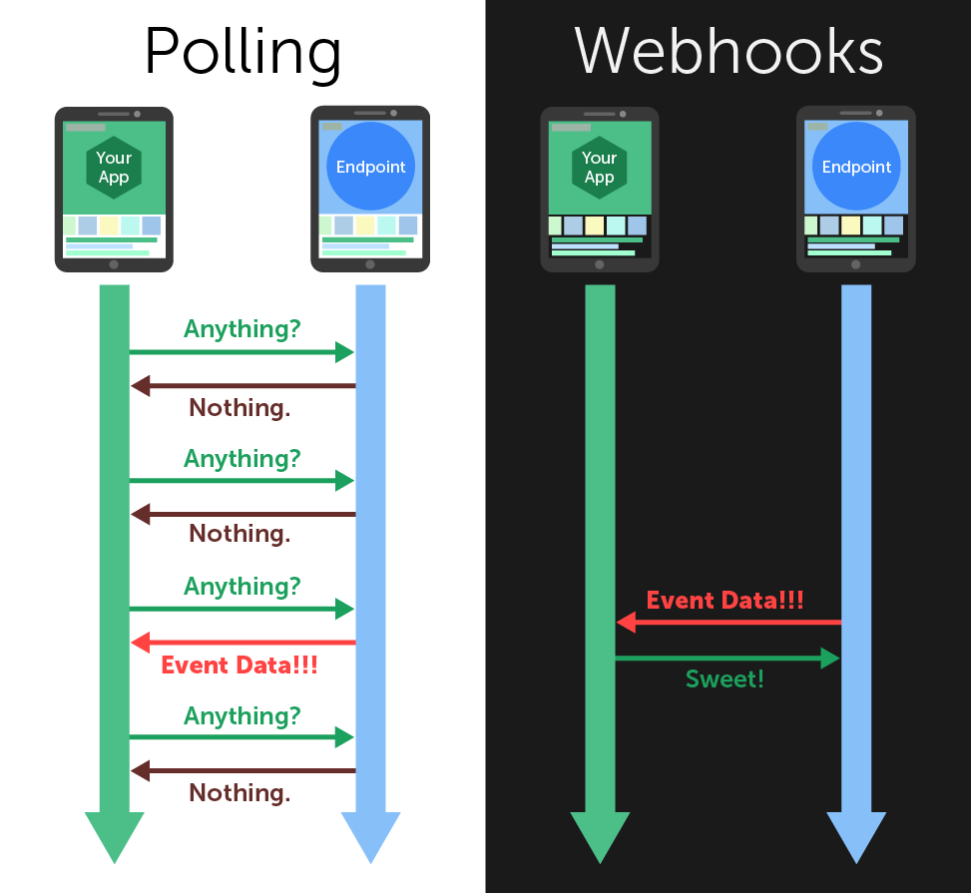
Fig: Diagramatic Representation of Polling and Webhook

Slide 14
Polling: Polling is a process in which repeated requests are send to the endpoint application for any changes in events (for eg: Create, Retrieve and Delete events) at a predetermined frequency (for ex: after every 12 hours) and wait for the endpoint to respond.
Webhooks: Instead of sending repeated requests for new events, we provide the endpoint with a URL. Whenever a new event occurs within the endpoint app, it posts the event data to our specified URL, updating our application in real-time.
Webhooks are superior to polling in terms of freshness of data, efficiency of communication and infrastructure costs. A communication standpoint, Zapier did a study across 30 million poll requests made through their service, and found that 98.5% of polls are wasted and they spent 66x more resources on polling.

Slide 15
3.2 Asynchronous use of marketing tags
When tags fire synchronously, one tag being slow to load slows down all the other tags that are waiting on it. And the longer a site takes to load, the more likely it is that people will leave without converting. Google Tag Manager (GTM) becomes very handy when we have lots of tags to manage because all of the code is stored in one place. GTM fire tags asynchronously, so they load independently from one another and don’t slow down our pages. Pages can load faster and data collection can start sooner.
There are three main parts to Google Tag Manager:
Tags: Tags are snippets of code or tracking pixels from third-party tools. These tags tell Google Tag Manager what to do.

Slide 16
Examples of common tags within Google Tag Manager are:
Google Analytics Universal tracking code
Adwords Remarketing code
Adwords Conversion Tracking code
Facebook pixels
Triggers: Triggers are a way to fire the tag that we set up. They tell Tag Manager when we want to fire tags on our site, either on a page view or on a link click.
Variables: Variables are additional information that GTM may need for our tag and trigger to work.

Slide 17
Advantages of Google Tag Manager:
It help our site load faster even after using many tags on our site.
It works with non-Google products.
Flexibility to play around and test out almost anything we want.
All third-party code is in one place.
GTM has a preview and debug mode so we can see what’s working and what’s not before we make anything live. It shows us what tags are firing on the page.
What can we track in GTM?
Events (link clicks, PDF downloads, add to cart click, remove from cart click)
Scroll tracking
Form abandonment
Shopping cart abandonment
Video views tracking
All exit link clicks

Slide 18
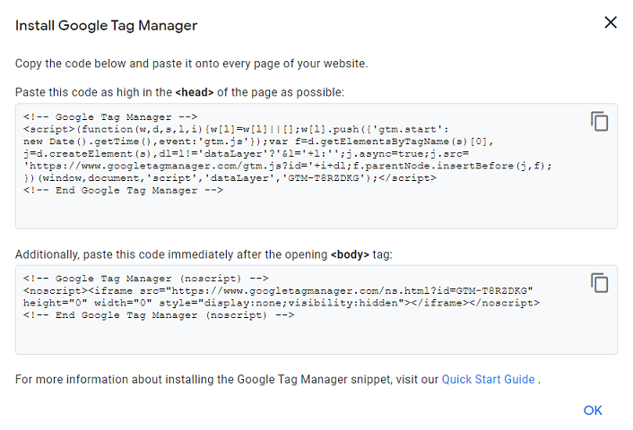
Fig: Google Tag Manager Tracking code

Slide 19
3.3 E-Commerce platform in Wordpress
WordPress (WordPress.org) is a free and open-source content management system (CMS) written in PHP and paired with a MySQL or MariaDB database. WordPress is the simplest, most popular way to create our own website or blog. In fact, WordPress powers over 35.2% of all the websites on the Internet. Some of important components of Wordpress that I have used for designing are as follows:
Elementor: Elementor is a drag-and-drop page builder for WordPress. This plugin helps us to create beautiful pages using a visual editor. It is designed to build dynamic websites quickly.

Slide 20
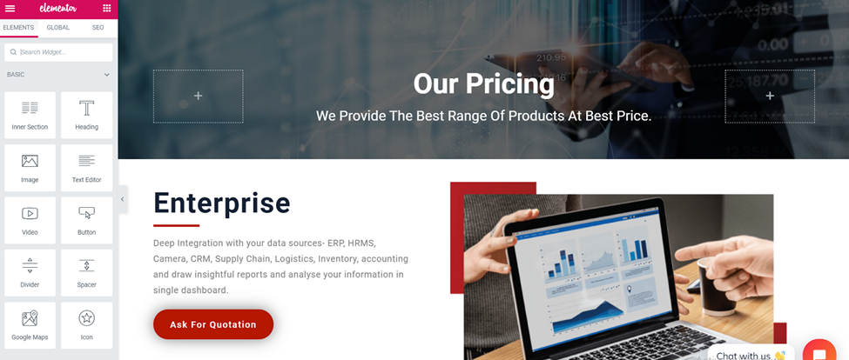
Fig: Pricing Page of GetPy.biz website built using Elementor

Slide 21
WooCommerce: By using the WooCommerce plugin I have designed the product archive page, single product page , cart page , checkout page and a thank you page, directed after a successful transaction.
Razorpay plugin for WooCommerce: Integrating an WooCommerce site with Razorpay allows us to accept payments via the Razorpay Payment Gateway. Razorpay is a payments solution which allows online businesses to accept, process and disburse digital payments through several payment modes like debit cards, credit cards, net banking, UPI and prepaid digital wallets.

Slide 22
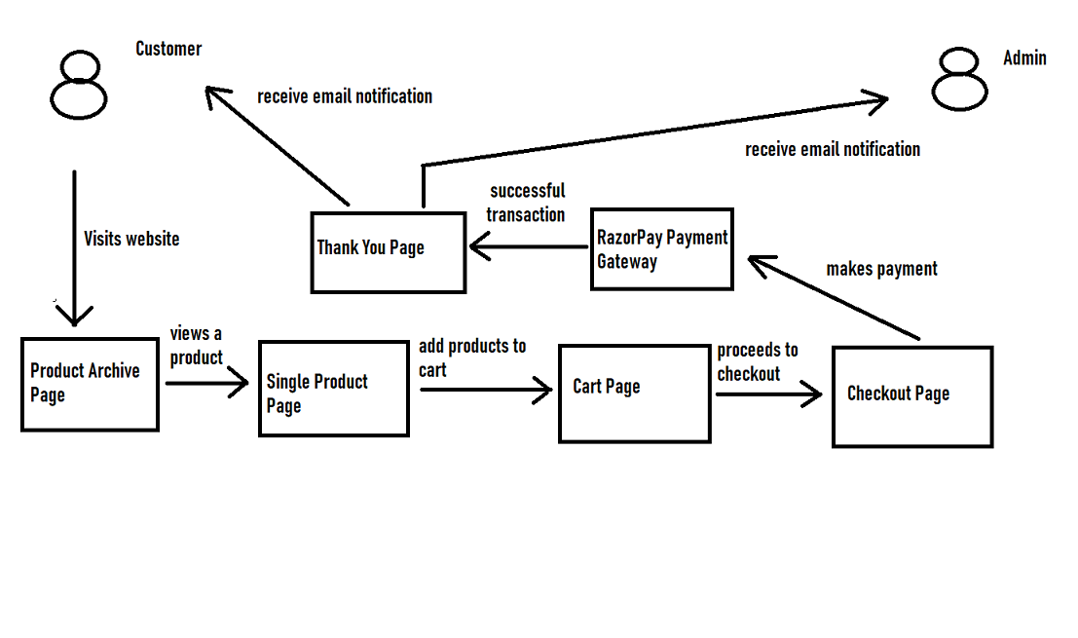
Fig: control flow diagram of GetPy.biz website

Slide 23
4. SYSTEM REQUIREMENTS SPECIFICATIONS
With the use of Webhooks, our application will receive the updated data in real-time from BigCommerce/Shopify API which will provide great value to our users.
By using Google Tag Manager we can promote our products in social medias such as Instagram, Facebook, Twitter, Linkedin or search engines such as Google Ads, Bing Ads etc as using several tracking codes simultaneously will not degrade our website performance. GTM gives a great boost in Internet Marketing of our ecommerce store.
By using WooCommerce we can create an ecommerce store in our Wordpress site. It is highly cost-effective and can target customers around the world.

Slide 24
5. SYSTEM DESIGN
5.1 Webhook in Azure Automation

Slide 25
5.1 Webhook in Azure Automation
Azure is Microsoft’s cloud computing infrastructure and platform designed to build, deploy and manage different applications and services through a giant network of data centres managed by Microsoft. To implement webhook in Microsoft Azure we need to understand the following components of Azure:
Azure Automation Account: Azure Automation delivers a cloud-based automation and configuration service that supports consistent management across Azure and non-Azure environments. It comprises process automation, configuration management, update management, shared capabilities, and heterogeneous features. Out of all these features I have used the process automation.

Slide 26
Process Automation: Process Automation in Azure Automation allows us to automate frequent, time-consuming, and error-prone cloud management tasks. By reducing errors and boosting efficiency, it also helps to lower our operational costs.
Runbook: Runbook is a set of tasks that perform some automated process in Azure Automation. It may be a simple process such as starting a virtual machine and creating a log entry, or we may have a complex runbook that combines other smaller runbooks to perform a complex process across multiple resources or even multiple clouds and on-premises environments.
For example, we might have an existing manual process for truncating a SQL database if its approaching maximum size that includes multiple steps such as:-
Connecting to the server
Connecting to the database
Get the current size of database
Check if the threshold has exceeded and then truncate it and notify user.
Instead of manually performing each of these steps, we could create a runbook that would perform all of these tasks as a single process. We would start the runbook, provide the required information such as the SQL servername, database name and recipient email and then sit back while the process completes.

Slide 27
Types of runbook:
Graphical: based on Windows PowerShell, created and edited completely in graphical editor in Azure portal.
PowerShell: Text runbook based on Windows PowerShell script.
Python: Text runbook based on Python
Runbook can be launched by different triggers such as:
Schedule
WebHook
Azure Alert
Logic Apps
Another Runbook

Slide 28
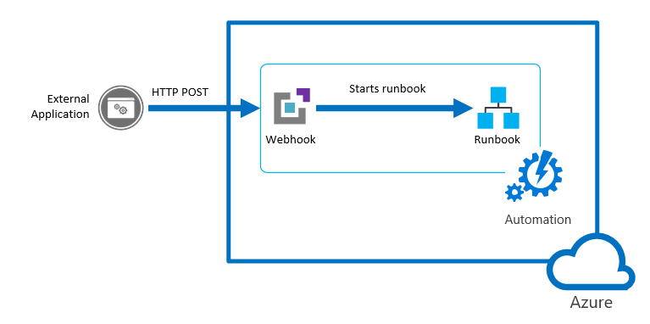
Starting a runbook from a webhook
A webhook allows an external service to start a particular runbook in Azure Automation through a single HTTP request. External services include Azure DevOps Services, GitHub, Azure Monitor logs, and custom applications. Such a service can use a webhook to start a runbook without implementing the full Azure Automation API.

Slide 29
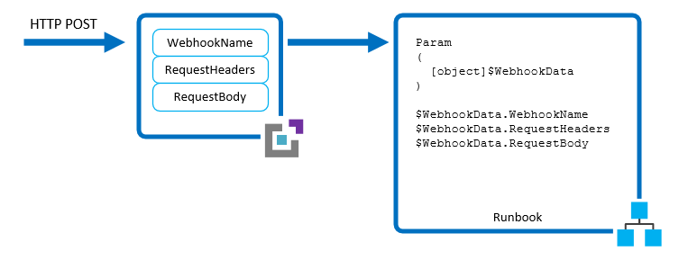
Fig: WebhookData Parameter Properties

Slide 30
conclusion
Ecommerce covers a vast areas of topic such as internet marketing, online transaction processing, inventory management systems, automated data collection systems etc. Covering all the areas of ecommerce and implementing them would take a huge amount of time. In the four months of my internship period, I have explored only a small portion of it. I have tried to meet the requirements of the project that I was assigned to within the limited period of time and with little experience. Working in this project has been an unique experience.

Slide 31
Thank you

